Slide 1
Case Details
Trauma Resource Kit
Performing the Trauma Primary Survey
Notes:
For use with: Link

Slide 2
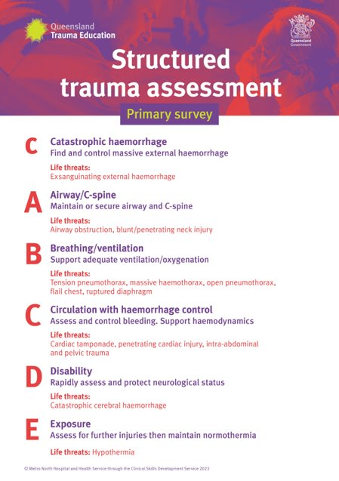
This slide deck has been designed as a visual aid to be used in conjunction with the "Performing the trauma primary survey - facilitator kit".

Slide 3
23 year-old-male
Large laceration R) shin from chainsaw
Simplified Poster
Notes:
C: Ongoing external haemorrhage from R leg wound requiring direct pressure and sutures to control. A: (A) VPU, Nil requirement for c-spine immobilisation. B: RR 28, Saturations 99% RA, C: HR 120, BP 120/80mmHg. D: GCS 15, PEARL 3+. BGL 7. E: Temp 36.5
Next Slide: Key Points

Slide 4
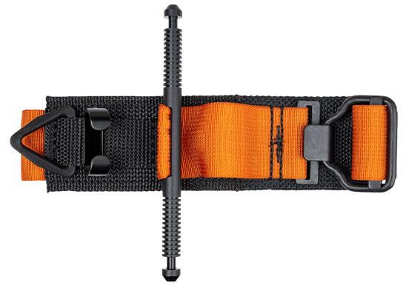
Key Points:
Life Threat: Catastrophic External Haemorrhage
Hypovolaemic Shock is the most common cause of shock in major trauma
Delegate haemorrhage control if required.
This may include:
Direct Pressure
Elevation
Indirect Pressure
Adjunctive Equipment
Notes:
(Relates to P9 & 10)
Next Slide: Case 2

Slide 5
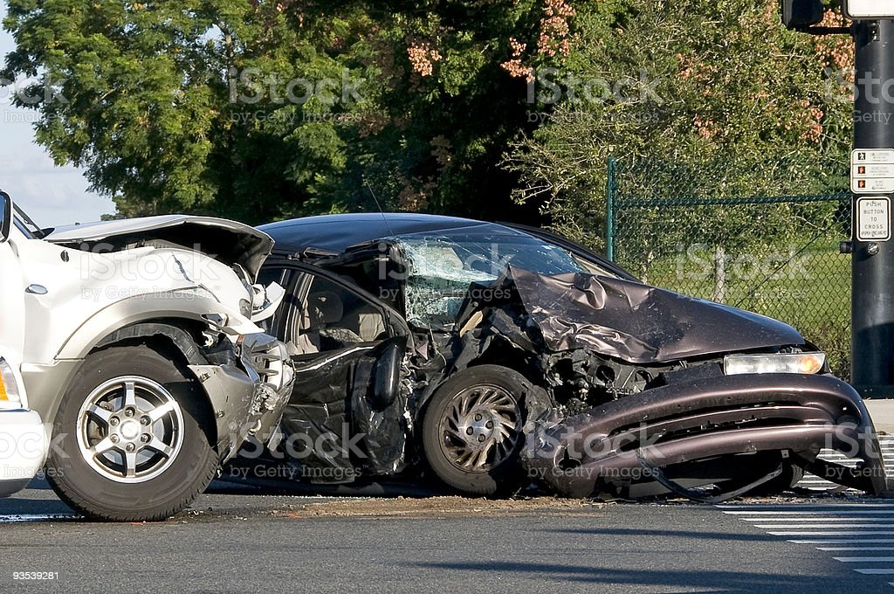
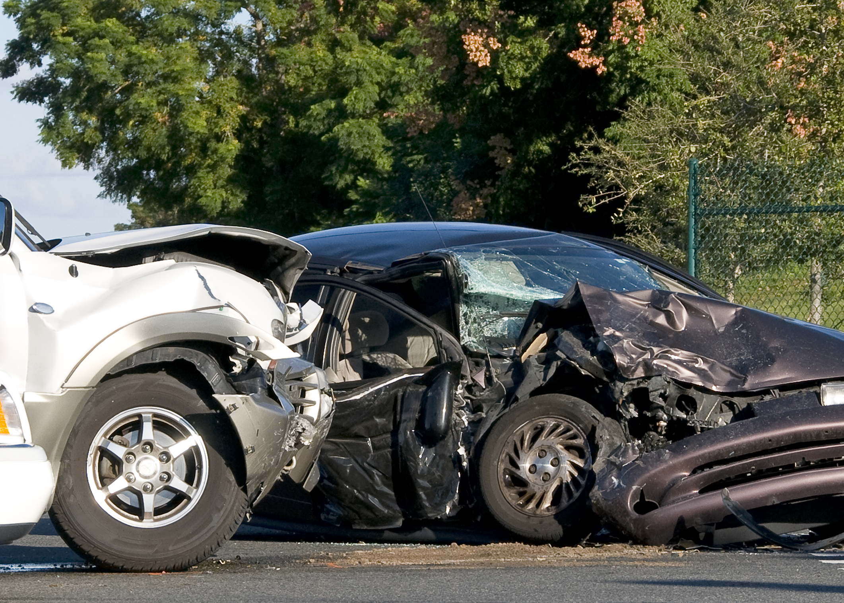
46 year-old-male
High Speed RTC with significant chest injuries
Simplified Poster
Notes:
C: Nil obvious external haemorrhage. A: (A) VPU, C-spine requires immobilisation. B: RR32, Saturations 80% RA (91% on 15L NRB). He complains of significant chest wall pain, trouble breathing and is hypoxic on room air. Clinical examination demonstrates crepitus and pain on palpation of his L chest wall with extensive subcutaneous emphysema. C: HR 120, BP 90/77mmHg D: GCS15. PEARL 4+. BGL 6.1 E: Temp 37
Next Slide: CXR

Slide 6
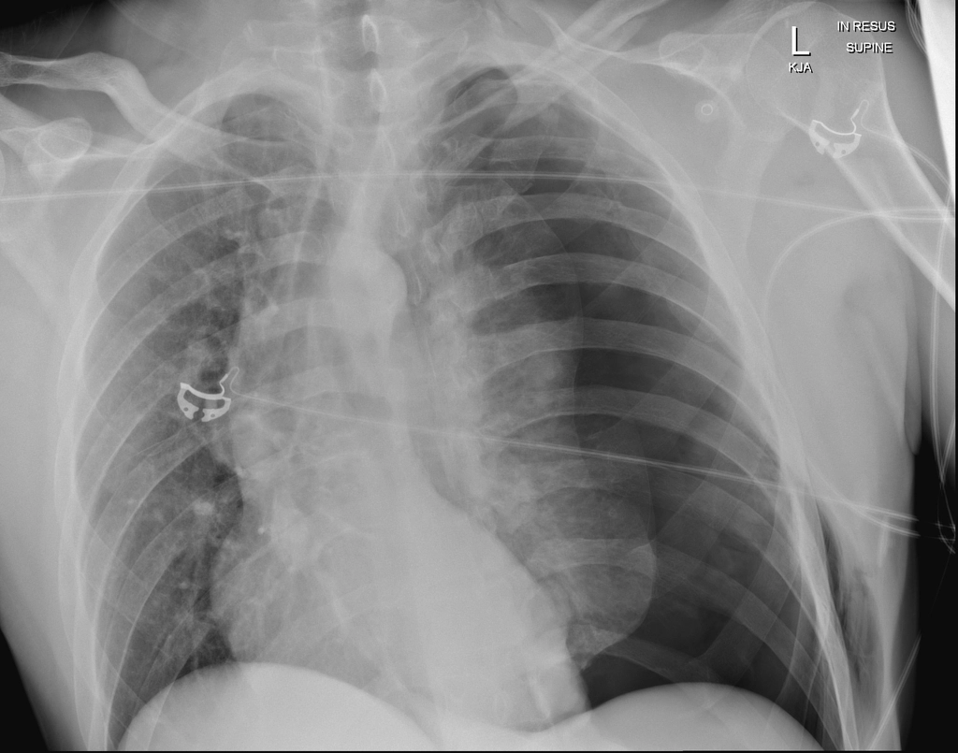
Notes:
CXR: L) Tension Pneumothorax. Case courtesy of Dr Andrew Taylor, Radiopaedia.org, rID: 67035
Next Slide: Key Points

Slide 7
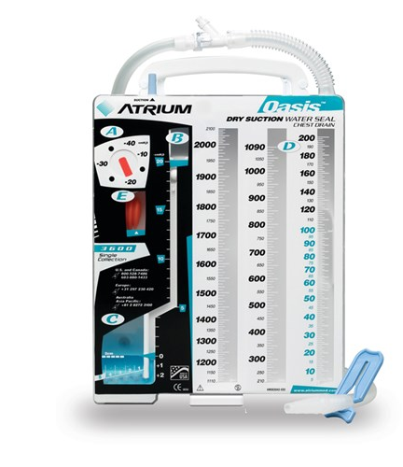
Key Points:
Life Threat: Tension Pneumothorax
This is a clinical diagnosis
Immediate management:
Needle Decompression (temporary only)
Finger Thoracostomy (check existing sites)
Intercostal Catheter Insertion
Notes:
Discussion Points:
(Relates to P14 & 15)
Patient may need tilted positioning due to not tolerating being supine whilst c-spine is immobilised.
Tension pneumothorax is a clinical diagnosis and does not require imaging prior to intervention. (Obvious chest injuries (pain, crepitus and subcutaneous emphysema). Hypoxia despite 15L 02 via NRB. Tachycardia and Hypotension. Tracheal Deviation is often discussed but rarely identified as it is an extremely late sign)
Needle decompression is very temporary, lasting only minutes.
In spontaneously breathing patients (who are creating negative intrathoracic pressure), ‘un-formalised’ finger thoracostomies require early management with the placement of an ICC to avoid the ‘sucking chest wound’ and creation of an open pneumothorax which may lead to obstructive tension physiology.
In patients receiving positive pressure ventilation (i.e., is intubated and paralysed) the risk of tension and obstructive physiology post finger/surgical decompression is lower, and an ICC should be placed when clinically able.
Re-open existing finger thoracostomy sites where there is signs of tension pathophysiology.
Next Slide: Case 3

Slide 8
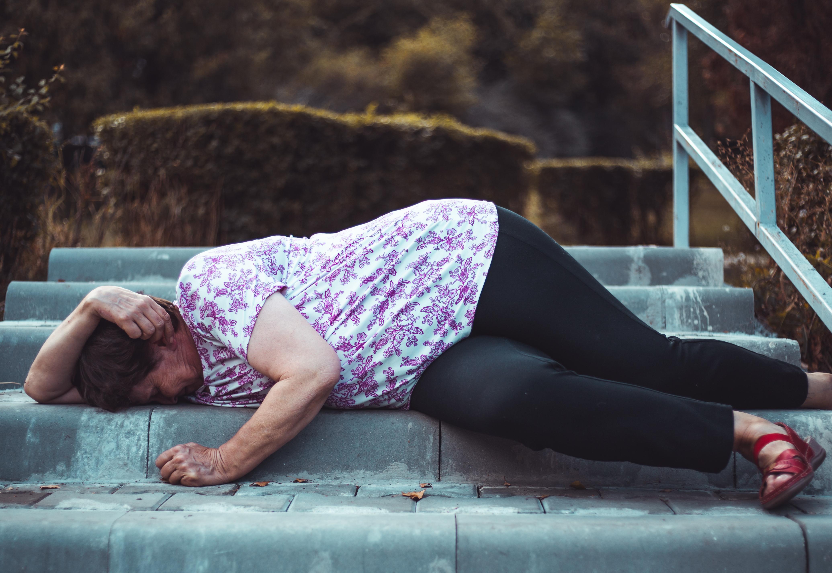
75 year-old-female
Found lying on footpath with large scalp laceration and ALOC
Simplified Poster
Notes:
C: Patient has sustained large scalp laceration, which is under a bandage applied prehospital. Nil catastrophic haemorrhage. A: AV(P)U, Soft collar insitu. B: RR20, Saturations 99% RA C: HR 80, BP 165/98. D: GCS 7 (M5). Pupils R 5mm, unreactive. Only localising to pain on LHS. BGL 6.5. E: Temp 36.5
Next Slide: CXR

Slide 9
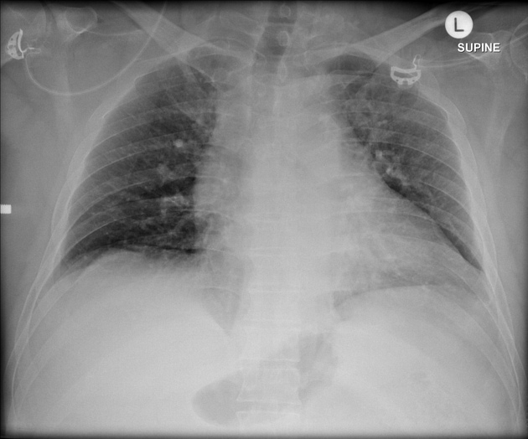
Notes:
CXR: Normal. Case courtesy of Dr Andrew Dixon, Radiopaedia.org, rID: 31551
Next Slide: PXR

Slide 10
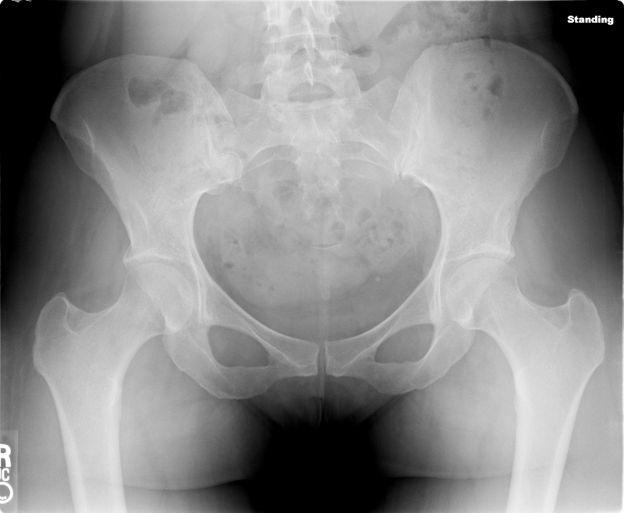
Notes:
CXR: Normal. Case courtesy of Dr Andrew Dixon, Radiopaedia.org, rID: 31551
Next Slide: Key Points

Slide 11
Key Points:
Life Threat: Airway Compromise, Significant Head Injury
Avoid head tilt
Consider early intubation
Anticipate difficult intubation (age, immobilisation), consider baseline GCS.
Trauma over 65 years is complex.
Notes:
Facilitator Notes:
(Relates to P11, 12, 13, 19 & 20)
Do you need to take control of airway immediately?
Significant airway risk due to GCS7 with ? Head injury – criteria for early intubation.
Geriatric Trauma:
Often under-triaged, less likely to have trauma activation
2/3 of female and 1/3 male injury related deaths occur over 65 years of age with 73% from falls - Major Trauma in the Older Patient - Evolving Trauma Care Beyond Management of Bumps and Bruises: Geriatric Trauma (acem.org.au)
2x mortality rate of younger patients with longer hospital stays
Complications related to comorbidities, age related anatomic and physiological changes.
Next Slide: Case 4

Slide 12
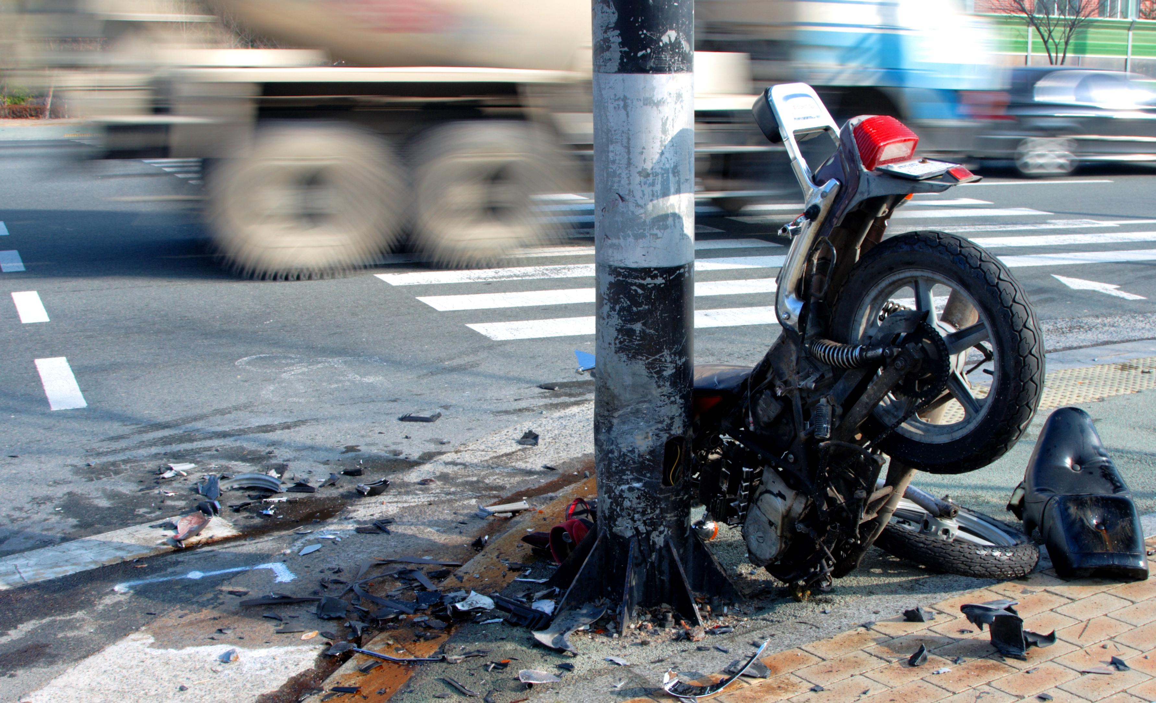
65 year-old-male
Motorbike vs Post 100kmph. Unstable Haemodynamics.
Notes:
C: Nil obvious external haemorrhage. A: A(V)PU, Soft collar insitu. B: RR24, Difficulty obtaining SP02. C: HR130, BP 90/54. Cool peripheries. Groin/Pelvic pain ++, PXR. D: GCS14 (E3V5M6). PEARL 2S. E: Temp 35.5
Next Slide: PXR

Slide 13
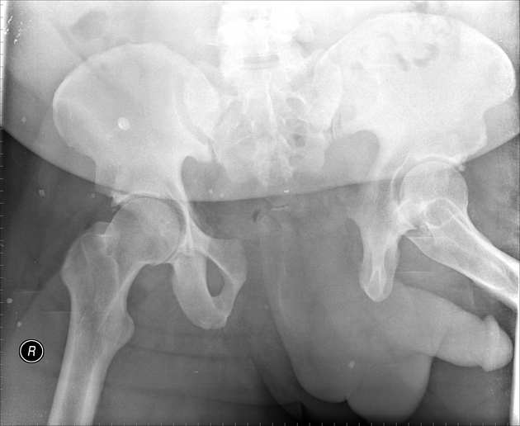
Notes:
Pelvic XR: Open book pelvic injury. Case courtesy of Dr Gagandeep Singh, Radiopaedia.org, rID: 6611
Next Slide: Key Points

Slide 14
Key Points:
Life Threat: Haemorrhage, Hypothermia
Pelvic binder with feed bound in internal rotation
Appropriate intravenous access (above the level of the injury)
Targeted resuscitation
Warming
Notes:
(Relates to P 16, 17, 18, 21 & 22)
Pelvic binders work to stabilise the pelvis, but may not limit bleeding. Disruption of the retroperitoneum leads to a non-compressible space for haemorrhage to accumulate.
Map 65mmHg in the absence of a suspected head or spinal cord injury.
Hypothermia is a critical factor in trauma care. It is a key part of the trauma triad of death, including hypothermia (low body temperature), Acidosis (which disrupts the blood’s ability to properly carry oxygen), and coagulopathy (blood that has a reduced ability to clot).

