Slide 1
Escharotomy in severe burns​
BURNS TRAUMA
Case discussion
Notes:
V2: Added some notes
Added ANZBA referral criteria
Clarified indications

Slide 2
Case study
28 year old male​
Found unconscious in a house fire​
Clothing on fire when pulled from the building​
Initial first aid with fire extinction, cool water and analgesia​
Intubated as GCS 7, facial burns, hypoxic

Slide 3
Initial Management:
Severity and need for referral based on ANZBA Criteria:
Location, size and depth of burn
Comorbidities
Potential inhalational injury​
Major Trauma, Chemical or Electrical Mechanism
Suspected Non-accidental injury
Notes:
Where and how this patient should be managed is dependent on a multitude of things, and these include the area, size and depth of the burn (age related), comorbidities (pregnancy and the extremities of age) and also mechanisms that may increase management complexity.
Always consider traumatic injuries as a result of a blast or fall, chemical exposure or suspicion of non-accidental injury.

Slide 4
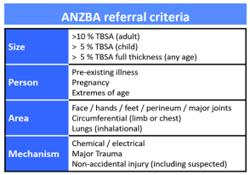
Case progress
The patient has circumferential, deep burns to bilateral upper limbs and chest​
Ventilator alarms for high airway pressures
Unknown circumstances
Notes:
In this case there are a number of concerns:
Circumferential burns to the chest and upper limbs is well over 10%, with difficulty ventilating and high pressures which occurs with poor chest wall compliance.
As he was found unconscious in a burning house we have very little understanding if there he has also experienced trauma outside of burns.

Slide 5
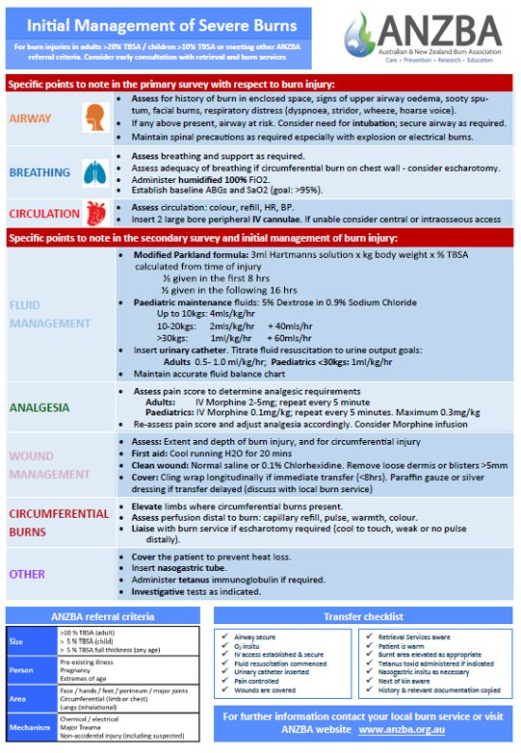
ANZBA Guideline
Notes:
Eschar is rigid and increasing oedema under inflexible skin may interfere with circulation.
The elevation of limbs should occur early, and be closely monitored.

Slide 6
Indications for Escharotomy​ (Chest)
Circumferential​ burns and/or restricted chest wall movement
Large TBSA % and depth​
Under, then over resuscitated​
Burns clinically: hard/no give
Consult with burns referral team prior to embarking on an escharotomy
Notes:
Note: In inhalational injury without a secured airway this is the priority over escharotomy.
Indication: Circumferential deep dermal and full thickness burns of the chest or limbs with respiratory or circulatory compromise.

Slide 7
Indications for Escharotomy​ (Limbs)
Loss of circulation​/perfusion
Pallor​
Reduced capillary return​
Coolness​
Loss of pulses is late sign​
Decreased pulse pressure on doppler US​
Numbness​
Decreased saturations on pulse oximetry of the limb​

Slide 8
Limbs
Post intubation - presence of the following :​
Circumferential full thickness burn to thorax and abdomen​
Reduced and restricted movement of the chest wall​
High ventilator pressures​
Reduced air entry bilaterally​
Hypoxaemia​

Slide 9
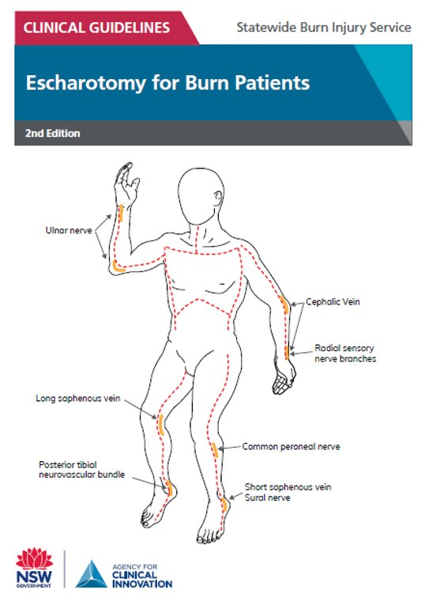
Anatomical landmarks

Slide 10
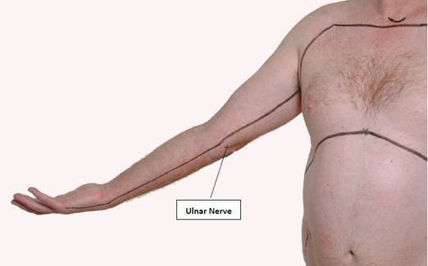
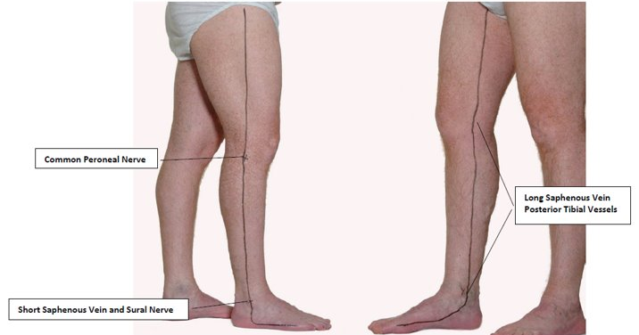
Recommended lines of escharotomy
RBWH Professor Pegg Adult Burns Service​
https://metronorth.health.qld.gov.au/rbwh/wp-content/uploads/sites/2/2017/06/recommended-lines-of- escharotomy.pdf

Slide 11
Preparation
Equipment​
Sterile drapes
Sterile procedure pack
Local anaesthetic
PPE - surgical gown, sterile gloves, surgical mask, safety goggles
Surgical pen
Ligature: suture/diathermy
Scalpel
Inner dressing - Alginate or impregnated gauze
Outer dressing - Melanin and crepe bandage
Notes:
Calcium Alginate Dressing (Algisite, Algosteril)

Slide 12
Procedure
Sterile skin prep and drape.
Adequate sedation/analgesia.
Mark where incision to be made.
Infiltrate LA to non-burnt skin 1cm beyond edge of burn.
Perform full thickness incision into subcutaneous fat (wound edges will separate).
Run a finger along the incision to detect residual restrictive areas.
Ensure incision on both sides of limb or chest to restore circulation.
Reassess circulation/respiration for effect following releasing tourniquet.
Diathermy/ligatures available for haemorrhage control.
Dress wound with alginate dressing or impregnated gauze.
Continue to assess limb circulation/chest expansion to ensure the procedure is effective.

Slide 13
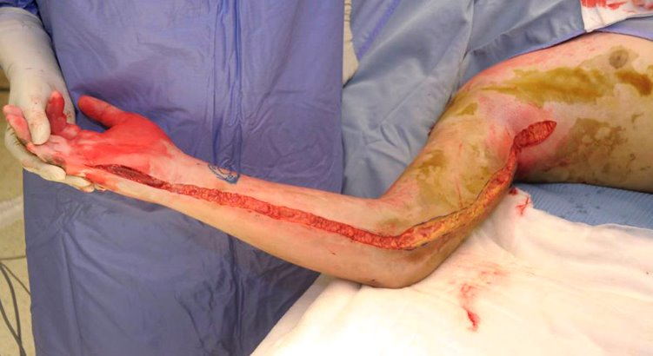
Upper limb

Slide 14
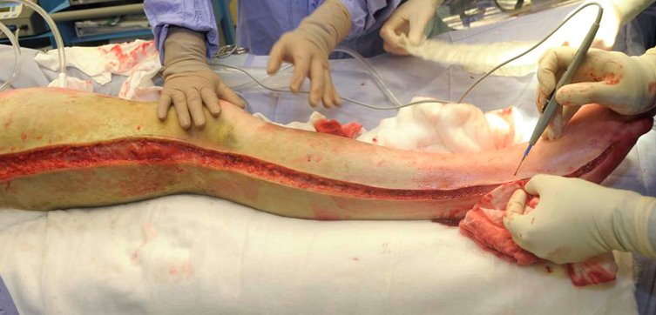
Lower limb

Slide 15
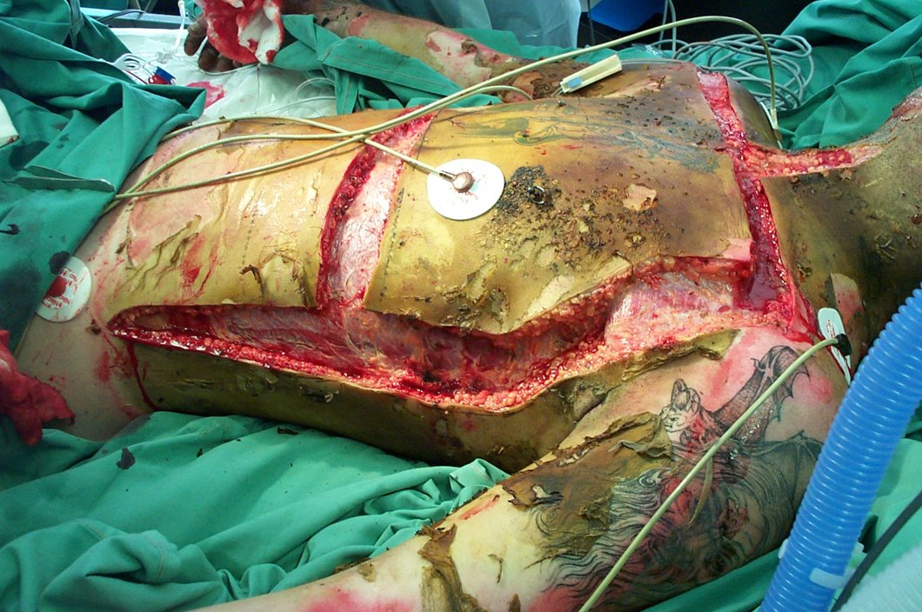
Chest

Slide 16
Tips and tricks​
Ensure limb in anatomical position to ensure accurate identification of landmarks.
Premark limb with surgical marker.
Incise skin depth to subcutaneous layer (NOT through muscle).
Ensure adequacy of release - run finger along wound to ensure no tight bands remain.
Extend 1cm beyond burnt skin (use LA to these areas).
Monitor for effect of tourniquet release/improves ventilation.
Continue general burn care.

Slide 17
References​
Agency for Clinical Innovation. NSW Statewide Burn Injury Service. (2019). Escharotomy for burn patients 2nd edition. Retrieved from: https://www.aci.health.nsw.gov.au/__data/assets/pdf_file/0003/162633/Escharotomy-for-Burn-Patients.pdf
ANZBA Initial Management Severe Burns https://anzba.org.au/assets/Initial-Management-of-Severe-Burns-2014.pdf
RBWH Prof Pegg Adult Burns Centre Guidelines https://metronorth.health.qld.gov.au/rbwh/wp-content/uploads/sites/2/2017/06/recommended-lines-of-escharotomy.pdf

Slide 18
Acknowledgements
Clinical content and images thanks to Prof. Michael Muller, FRACS, RBWH Burns Service.

