Slide 1
Imaging in trauma
CHEST TRAUMA

Slide 2
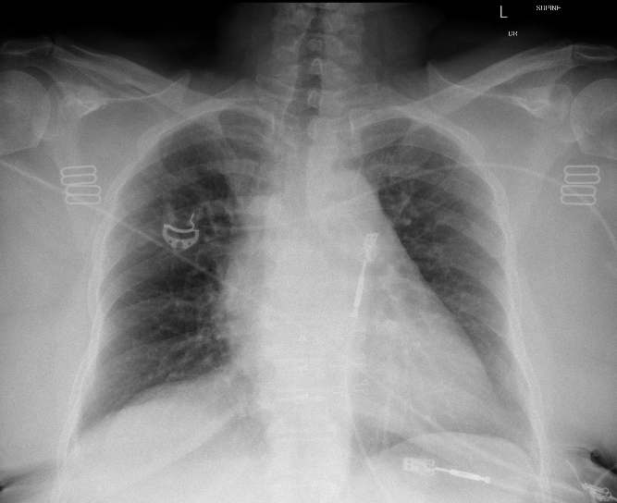
Normal CXR
ABCDE
Airway: trachea, carina, bronchi and hilar structures.
Breathing: lungs and pleura.
Cardiac: heart size and borders.
Diaphragm: including assessment of costophrenic angles.
Everything else: mediastinal contours, bones, soft tissues, tubes, valves, pacemakers and review areas.
Notes:
Normal supine trauma CXR- systematic assessment.
This CXR: supine CXR, ECG leads and bra clips. Hear CTR enlarged (despite AP projection). No PTx, rib fractures or pleural collection or pulmonary contusion.

Slide 3
Role of CXR in trauma

Slide 4
Notes:
Whilst the assessment of CXR must include all zones to give an accurate interpretation most trauma films will appear like this supine trauma CXR - missing lung bases. This is often due to the patient being positioned unevenly on the trolley and the alignment assessment more challenging than in the radiology department with a mobile erect patient. When reviewing these images - the decision needs to be made regarding the index of suspicion, the areas missing on plain film and the next steps - will they have a CT or spine cleared and repeat formal erect CXR.
In trauma what are we trying to assess with the portable CXR?
Life threats: tension Ptx/Htx, multiple rib fractures, mediastinal pathology, diaphragmatic injury and other bony/soft tissue trauma - either for immediate intervention decisions or because it will change the next imaging profile - will you get a CT, CTA or ECHO?

Slide 5
Post processing effects

Slide 6
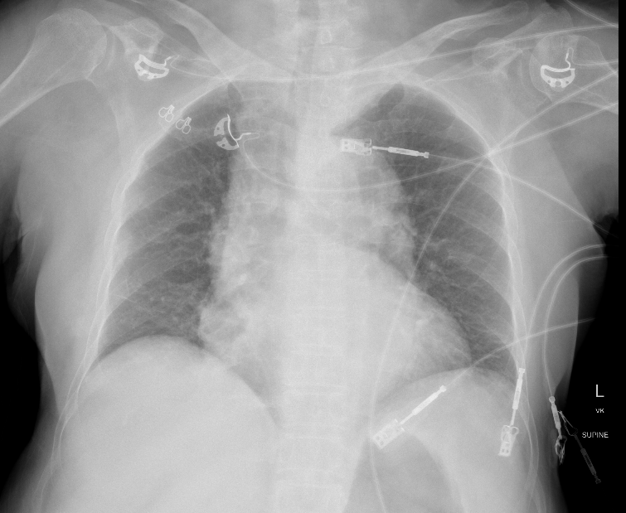
Notes:
In many hospitals the CXR will appear like this. This is a supine trauma film, without beam hardening. There are subtle R lateral rib # which are almost impossible to see on this image.

Slide 7
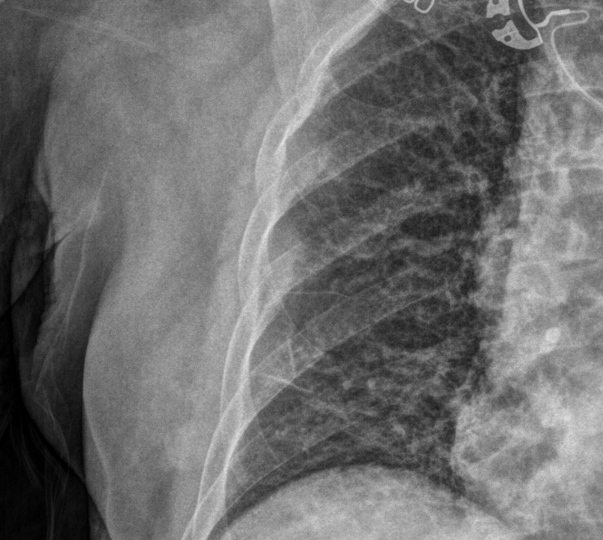
Notes:
This is the same patient, with post processing to a beam hardened format. On this, the 6-7th lateral rib # are more visible. This is also shown on close-up.
This mode is also good for the identification of a pneumothorax.

Slide 8
Patient positioning and CXR interpretation

Slide 9
Erect CXR
Notes:
There are considerations to remember when interpreting the supine CXR - including how air and fluid will appear and the mediastinal structures appearance. In the erect film, air will gather in the apices and fluid in a meniscus obscuring the diaphragm.

Slide 10
Haemothorax
Notes:
Supine film - veiling opacification.
Erect film - meniscus, diaphragm obscuration.

Slide 11
Pneumothorax
Notes:
A pneumothorax will appear differently on an erect vs supine CXR.
In the supine film - a pneumothorax may appear as a deep sulcus, with an etched mediastinum (border of heart very distinct), widened rib spaces, mediastinal shift. Can also see lung edge on this CXR.
In an erect film a pneumothorax can be seen as shown - obvious lung edge and a flattened diaphragm (also, this CXR has: 1 x rib #, small amount subcut emphysema).
Case courtesy of Dr Sajoscha Sorrentino, Radiopaedia.org, rID: 14780

Slide 12
Notes:
Some patients have significant bilateral chest injury. This CXR shows the presence of pneumothorax with gas stranding through the pectoral muscle fibers stranding on L and subcutaneous emphysema on R indicate bilateral pneumothorax. So whilst the pneumothorax can not be seen, the diagnosis can be made by these secondary signs.

Slide 13
Tension pneumothorax
Notes:
Sometimes a tension pneumothorax will be seen in the trauma bay - this is evidenced by mediastinal shift from a large pneumothorax. However, this remains a physiological diagnosis **NOT** radiological.

Slide 14
Limitations of CXR

Slide 15
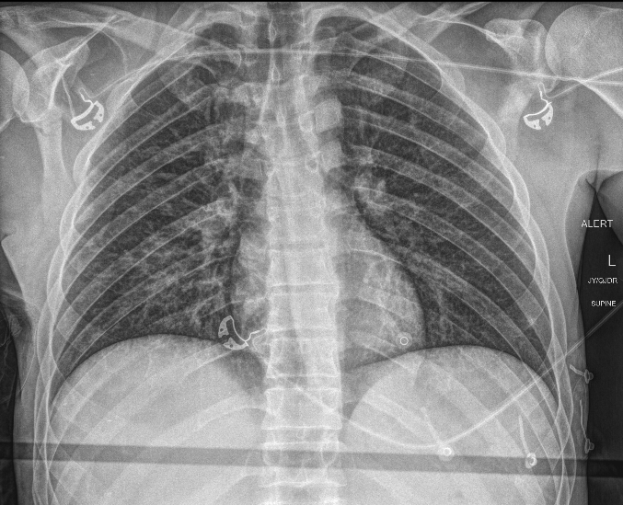
Notes:
High speed MBC vs back of truck, thrown 30 meters.
What injuries can you see?
L midshaft clavicle, R scapula.
3166489

Slide 16
CT imaging
Notes:
The CT gives significantly more definition to the injuries - as the rib fractures and pulmonary contusions were not evident on the CXR.
The CT shows: R rib 2-6, L rib 1-4, bilat pulm contusion, R scapula, L clavicle, small R apical PTx.
Video requires an internet connection to play: https://vimeo.com/538909400

Slide 17
Patient cases

Slide 18
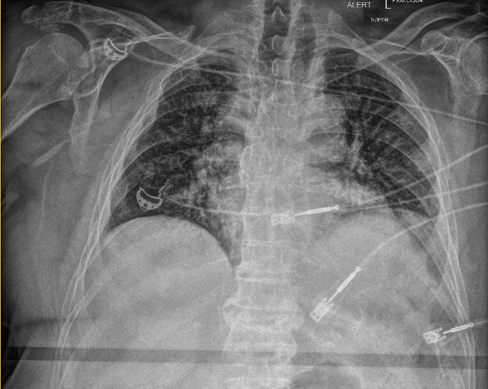
Case 1
Notes:
An elderly male is brought to ED after riding a tricycle down hill which has been t boned by a car. He is hypotensive and hypoxic on arrival to ED. What can you see?
R rib fractures.

Slide 19
Case 1 CT
Notes:
He undergoes a CT - what injuries can you see now?
R rib 1-10, L 6th rib, comminuted R scapula, small R Htx.
Urn: B965617

Slide 20
Deterioration over a few hours
Notes:
Over 4 hours - progressive resp distress. This was after he was given large volume fluid resuscitation as part of ta massive transfusion for hypotension and presumed bleeding. Due to the deterioration he needed to be intubated and ventilated. What lines/tubes have been placed?
ETT/OGT well positioned, cardiac monitoring.

Slide 21
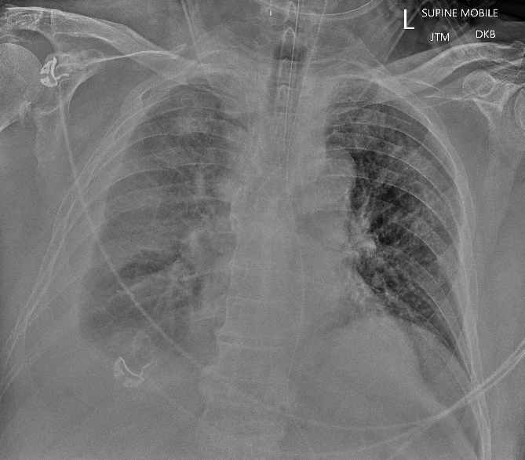
Day 3 admission
Notes:
He remains in ICU ventilated and 3 days later noted to have worsening gas exchange. What can you see on this Xray (note supine)?.
Opacification of R hemithorax, meniscal line, mediastinum ok - suggestive of large R HTx.

Slide 22
Notes:
He then undergoes placement of an ICC and this CXR taken post R ICC placement. What do you think about the ICC?
There is improvement in the Htx, but note the drain is in too far - would need to check it is working clinically.

Slide 23
Summary
Chest injury can progress over time.
Expect increase in haemothorax with multiple rib fractures.
Repeat imaging with any clinical changes.

Slide 24
Case 2
Notes:
A 46yo female is involved in a high speed RTC, there is significant impact to the driver (which is the patients) side.
1. What abnormalities do you see - what are you concerned about?
Diaphragmatic injury.
Elevation of the right hemidiaphragm with patchy consolidation and atelectasis throughout the right lung. Distortion right liver contour consistent with diaphragmatic rupture with partial herniation of the liver. Mild leftward mediastinal shift. Small right pneumothorax. Right seventh and twelve rib fractures are not well delineated.
2. She is hypoxic with stats 90% NRB and RR 32. Will you put an ICC in for her worsening respiratory distress?
Care and cautio n- needs to be placed higher than normal due to diaphragmatic injury.
May decide to intubate her prior to ICC insertion.
1870080

Slide 25
Summary
Examine diaphragm for injury.
Will alter placement of ICC if diaphragm injury present.

Slide 26
Ultrasound in chest trauma

Slide 27
Ultrasound and pneumothorax
There are four signs you can use to help you in the evaluation of a PTX:
Sign | What it looks like | How you use it
Lung sliding | Back and forth movement of pleural line. | If you see lung sliding, you don’t have a PTX in that area. If you don’t see lung sliding, it doesn’t mean you have a PTX.
B-lines | Vertical white artifacts that start at the pleural line, go all the way to the bottom of the screen and can move with respiration. | If you be b-lines, you don’t have a PTX in that area.
Lung point | Lung sliding and lack of lung sliding on the same screen. | If you see a lung point, there’s a really high chance the patient has a PTX. Be careful around the heart and around the diaphragm. Both of these areas cause false-positive lung points.
Lung pulse | Rhythmic subtle movements of the pleural line that move in sync with the heartbeat. | If you see a lung pulse, the patient doesn’t have a PTX.

Slide 28
M mode
Notes:
M mode can be used to visualise pleural movement.
On the left is normal - this is the sea-shore sign which indicates normal pleural movement. You can see the waves on the beach.
On the right is abnormal - this is the stratosphere sign - which indicates no pleural movement.

Slide 29
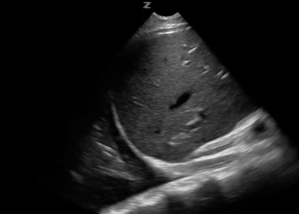
Ultrasound and Haemothorax
Notes:
A haemothorax is identified by a fluid, anechoic collection above the diaphragm. Often can visualise the collapsed lung as it floats in the fluid. Demonstrated here is the ‘spine sign’ which is the visualisation of the vertebrae in the thoracic cavity - in normal aerated lung the spine is not seen, but with a haemothroax the fluid transmits the sound waves allowing visualisation.

Slide 30
CT imaging in chest trauma

Slide 31
Decision rule - Canadian
SCRAP variables:
Saturations < 95% RA or < 98% on O₂
CXR abnormality
RR > 28
Auscultation abnormality
Palpation abnormality
Notes:
Rules have been developed to aid decision making around use of CT imaging in trauma. This is one example of a decision rule. Like most rules - it is often the documented ‘clinician gestalt’ as these findings would prompt advanced imaging in most centres.
With this rule = no variables = no patients with injury out of 434 examined in the study.
The rule is not useful in penetrating trauma, kids or GCS < 9.

Slide 32
CT benefits
Notes:
Benefits of CT include the identification of injuries, allows localisation of the exact number of ribs fractured, where and if flail segments are present- this allows the block type to be determined and if there is significant rib fracture displacement in some centres surgical stabilisation will be offered.
CT also allows the creation of a 3D recon of chest injury this allows assessment of rib displacement to aid decision for surgical stabilisation of rib fractures.
Technique - CTA - all major trauma has arterial phase - so great vessel injury identified and upper abdo contrast for solid organ vascular injury (blush).
Arm position important - above head if able or on pillows, otherwise arms by side will significantly degrade the image with artifact.
This coronal image shows artifact through liver and spleen making injury identification harder

Slide 33
Intercostal catheters

Slide 34
ICC good position
Notes:
The L ICC is well placed within the thoracic cavity. It does not abut mediastinal structures or the diaphragm. The side ports are within the thoracic space.

Slide 35
Pigtail catheter
Notes:
Example of pigtail drain as comparison - not regularly used in trauma due to blood associate with rib #s (each rib can bleed about 100mls).

Slide 36
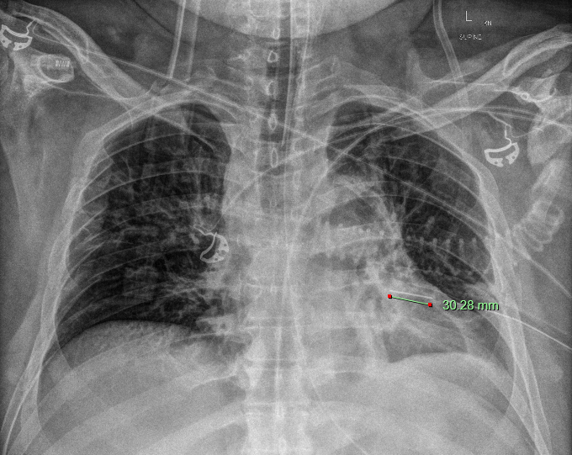
ICC vs thoracic drain
Notes:
Local available equipment is important to know.
An Intercostal catheter (ICC) - has a distal drainage hole 2-3cm from tip vs a thoracic drain has distal holes 6-10cm from the tip. This impacts on how far in the chest the drain must be placed and therefore may lead to complications if the drain is not far enough or too far in.

Slide 37
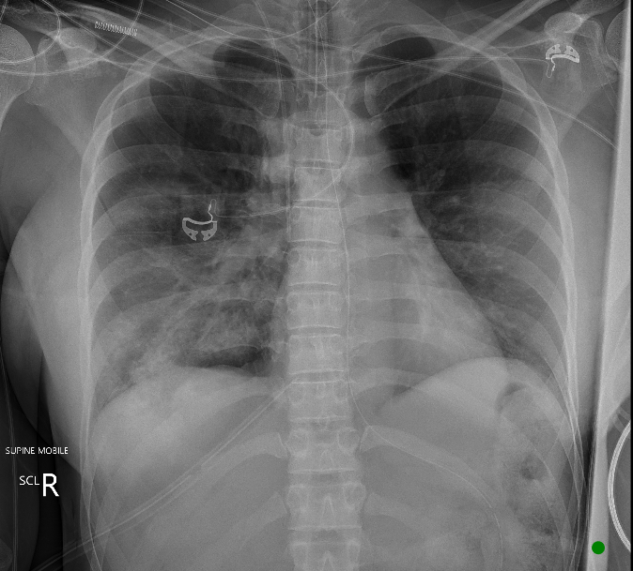
ICC in poor position
Notes:
Here you can see the ICC is placed too low in the chest wall - well below triangle of safety! Aiming 5th intercostal space.
In this image - there are 4 ICCs - 2 of which appear kinked - in this case you need to clinically assess drain function, but if no bubble/swing - would pull back 5cm to see if it will un-kink. The R anterior ICC also appears too low.

Slide 38
ICC in poor position
Notes:
Here is another ICC which is too low and too far in - it is kinked within the left pleural space.
Case courtesy of Dr Sachintha Hapugoda, Radiopaedia.org, rID: 59664.

Slide 39
Good or not
Notes:
Are these ICCs well placed or not?
The first image: the L ICC has been placed in the 7th ICS, so a bit low, but side port is well within thoracic cavity and the tip of the drain is not abutting mediastinum.
In the second image: the R ICC - drain hole? within thoracic cavity - almost falling out - often occurs with poorly secured drains.
→ Check clinical function - concern is when post outside thoracic cavity - wont drain and will worsen subcutaneous emphysema.

Slide 40
Good or not
Notes:
This L ICC is placed post traumatic cardiac arrest. Is the position good?
Case courtesy of RMH Core Conditions, Radiopaedia.org, rID: 27926

Slide 41
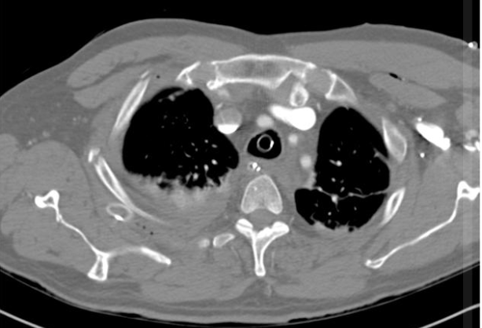
Good or not
Notes:
The ICC is extra thoracic - tunnelled in the posterior chest wall and not within the thoracic cavity.
Case courtesy of RMH Core Conditions, Radiopaedia.org, rID: 27926

Slide 42
Surgical stabilisation

Slide 43
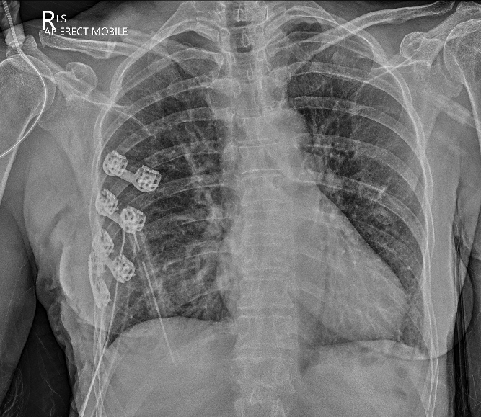
Rib surgical stabilisation
Notes:
Surgical stabilisation of rib fractures is emerging as a treatment for multiple rib fractures. Previously only performed by cardiothoracic surgeons and only indicated in flail chest in whom invasive ventilation can not be weaned. Now → indicated in multi level rib fractures, uncontrolled pain and if rib fracture displacement is present. The aim of rib fixation is to reduce long term pain and improve ventilatory function/avoid I&V/reduce hospital and ICU LOS.

Slide 44
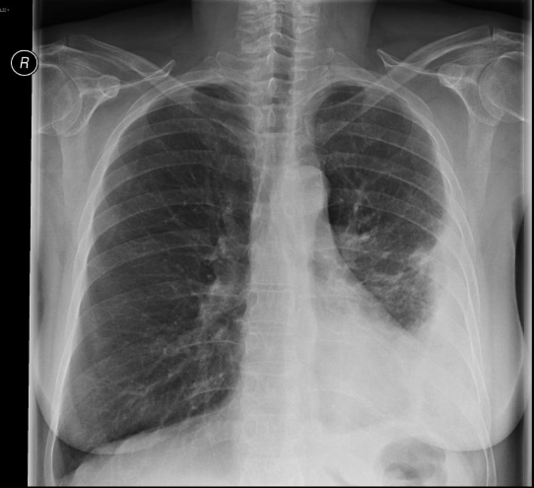
Complications
Notes:
Complications can occur with both ICC use and retained haemothorax - so ICCs are routinely only kept for 5 days. An empyema is pleural fluid is typically unilateral or markedly asymmetric. Generally, empyemas form an obtuse angle with the chest wall, and due to their lenticular shape are much larger in one projection (e.g. frontal) compared to the orthogonal projection (e.g. lateral). The lenticular shape (biconvex) is also suggestive of the diagnosis, as transudative/sterile pleural effusions tend to be crescentic in shape (i.e. concave towards the lung, see empyema vs pleural effusion). Ultrasound can be used to identify loculation.

Slide 45
Summary
CXR primary survey in trauma.
Identify life threats.
CTA chest if evidence of injury or clinical concerns.
Pain management, surgical stabilisation, great vessel injury.
US – identify pneumothorax/haemothorax – beware subcutaneous emphysema.
Surgical stabilisation of major chest trauma.
ICC positioning challenges – always confirm clinically.

