Slide 1
Haemostatic Resuscitation

Slide 2
Acute Traumatic Coagulopathy
Haemorrhagic shock following trauma
Lethal triad PLUS acute trauma coagulopathy
25-35% severely injured will have TAC on presentation to ED
Inc risk of death from trauma by 8x
Results from hypoperfusion, hyperfibrinolysis and fibrinolytic shut down

Slide 3
Management options
Balanced transfusion (1:1:1) vs Viscoelastic haemostatic assay

Slide 4
Viscoelastic Haemostatic Assays (VHAs)
Queensland- ROTEM or TEG
TEG= thromboelastography
moving cup in limited arc
pin/wire measures clot formation
ROTEM= rotational thromboelastometry
immobile cup
moving pin/wire to measure clot formation
Not directly comparable parameters as difference coagulation activators are used

Slide 5
Benefits
Quicker than formal coagulation tests (5 vs 40 minutes)
Assessment of global clotting function not just time to fibrin formation
Can identify coagulopathy from low fibrinogen vs low platelets
May decrease the use of blood products compared to ration based resuscitation
Best measure of fibrinolysis

Slide 6
Costs
Initial education/training for test acquisition and interpretation
Needs to be stable- not suitable for prehospital or transfer settings
Machine warms blood to 37 deg, therefore not reflection of pathology with the hypothermic patient
Regular servicing and calibration
More expensive
Does not identify warfarin or NOACs (non specific findings)

Slide 7
Controversies
Does it improve outcomes: maybe
Does it reduce product usage- probably yes: Gonzalez 2016

Slide 8
TEG interpretation
Brandy tumbler
Do nothing
Red wine glass
Give FFP
Test tube
Give platelets
Champagne flute
Give cryoprecipitate
Upside down martini glass
Give TXA

Slide 9
Terminology for ROTEM and TEG
ROTEM | TEG
Clotting time (CT) | R value (reaction time)
α angle and clot formation time (CFT) | K value and α angle
Maximum clot firmness (MCF) | Maximum amplitude (MA)
Clot lysis (CL) | LY30

Slide 10
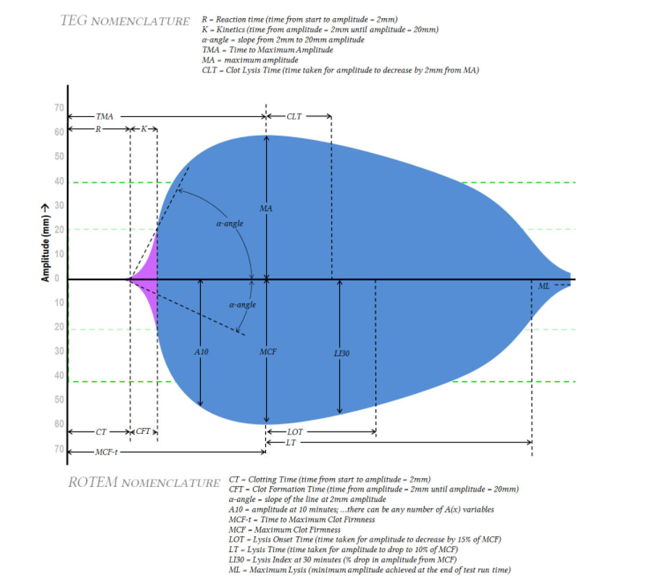

Slide 11
Treatment-based approach to TEG and ROTEM

Slide 12
Useful resources
Gonzalez E, Moore EE, Moore HB, et al. Goal-directed Hemostatic Resuscitation of Trauma-induced Coagulopathy: A Pragmatic Randomized Clinical Trial Comparing a Viscoelastic Assay to Conventional Coagulation Assays. Ann Surg. 2016;263(6):1051-1059. doi:10.1097/SLA.0000000000001608
Sankarankutty A, Nascimento B, Teodoro da Luz L, Risoli S. TEG and ROTEM in trauma: similar test but different results? World Trauma Congress 2012. World J Em Surg 2012, 7 (sup 1): 53. 1749-7922-7-S1-S3.pdf (biomedcentral.com)
Hunt H, et al. "Thromboelastography (TEG) and rotational thromboelastometry (ROTEM) for trauma‑induced coagulopathy in adult trauma patients with bleeding." Cochrane Database of Systematic Reviews 2 (2015).

