Slide 1
Delayed respiratory deterioration post blunt chest trauma
CHEST TRAUMA
Immersive scenario

Slide 2
Learning outcomes
By the end of this session, participants will be able to:
Identify patient and injury-related factors that place a patient at greater risk of respiratory complications post chest trauma.
Identify three key signs of impending respiratory deterioration – poorly controlled pain, impaired inspiration, and impaired cough.
Demonstrate the skill of teaching a patient the correct incentive spirometry technique.

Slide 3
Overview
Chest trauma is the second most common traumatic injury in non-intentional trauma.
After blunt chest trauma patients are managed in a number of locations including the emergency department, the intensive care unit, a dedicated trauma unit, or orthopaedic, medical or surgical wards.
Ongoing assessment and early identification of respiratory deterioration is crucial as patients who appear stable on early assessment may later deteriorate on the ward due to respiratory complications such as lung contusion, atelectasis, and pneumonia.

Slide 4
Factors associated with a higher risk of respiratory complications
Number of ribs fractured (>3)
Age (>55 years)
Other serious injury such as head, extremity, abdominal, cardiac, or spinal cord injury
Smoking history or chronic lung condition

Slide 5
Structured assessment
A – Airway | voice, airway noises
B – Breathing | RR, SpO2, chest wall movement
C – Cardiovascular | HR, rhythm, BP
D – Disability | assess GCS, pain rating scores
E – Exposure | assess other injuries, ICC observations

Slide 6
Best practice management
Regular monitoring and patient assessment
Early identification of at-risk patients and signs of respiratory deterioration, through:
Early Warning Scores (EWS)
“Pain, Inspiration, Cough ”
Effective pain management
Optimisation of lung volumes and cough effectiveness
Chest physiotherapy
Upright positioning / sitting out of bed
Incentive spirometry devices can be used as a visual aide to teach optimal deep breathing technique (slow, deep breath with inspiratory hold)
Humidified high flow oxygen
Multidisciplinary care and communication
Acute Pain Management Service

Slide 7
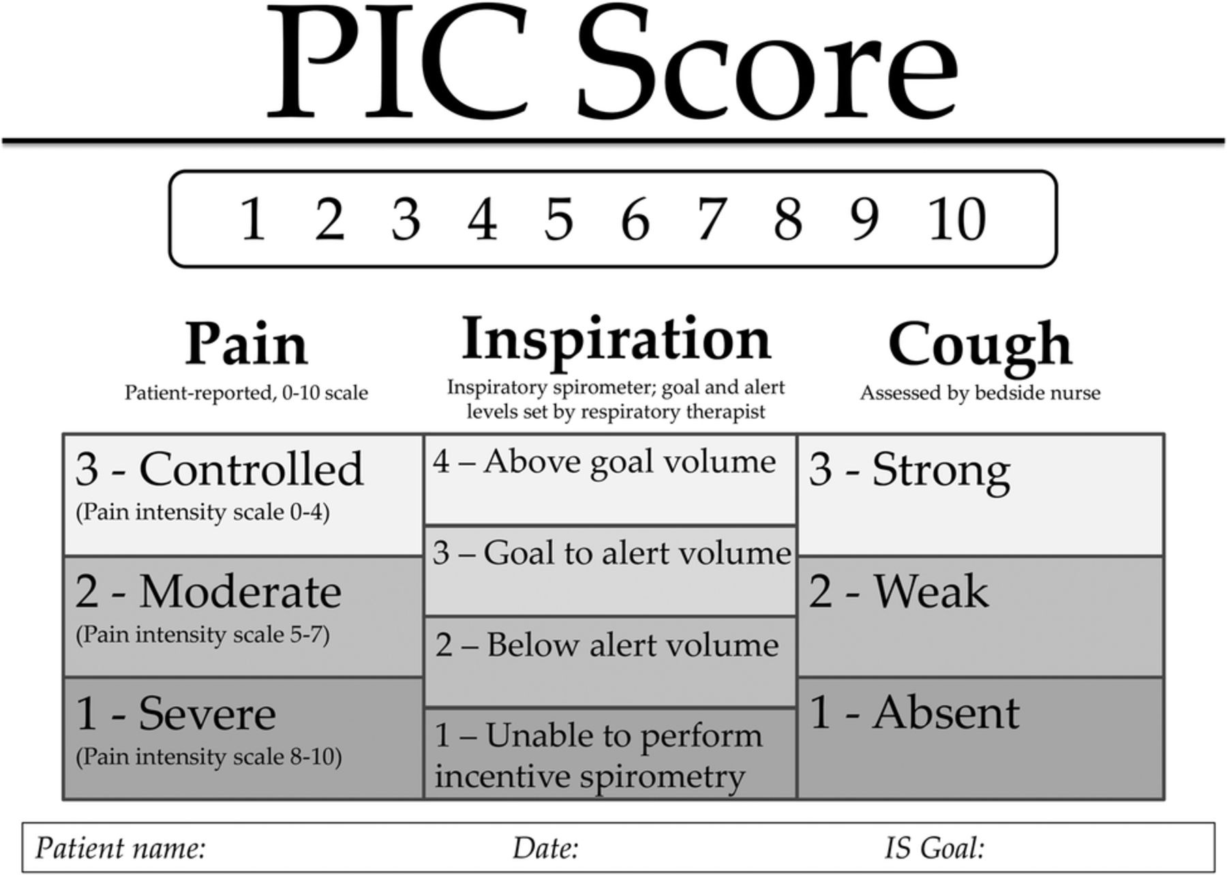

Slide 8
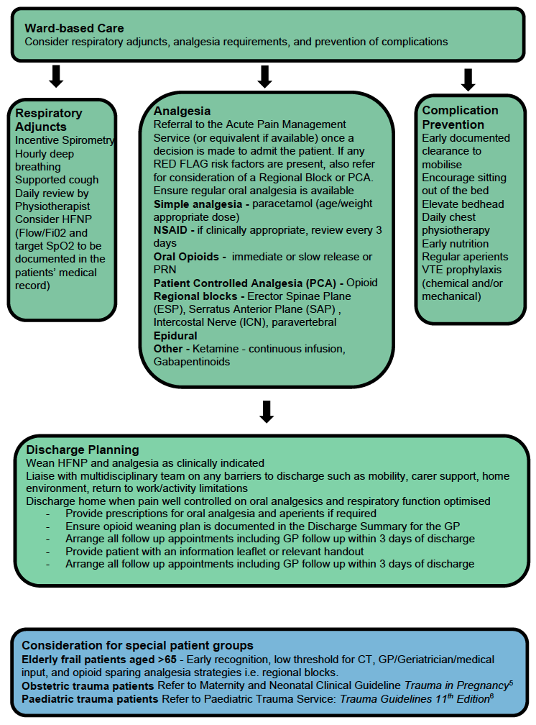
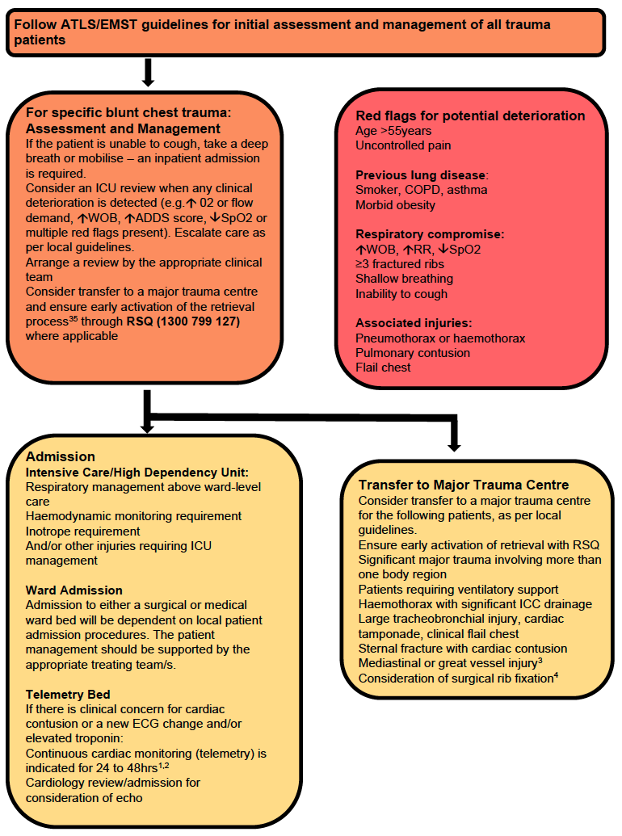
Statewide Blunt Chest Guideline
Notes:
Discuss initial management and highlight the red flags, then focus on ward-based care and management.

Slide 9
Acknowledgements
Authored and developed by Alison Blunt, Advanced Physiotherapist – Princess Alexandra Hospital

