Slide 1
Blunt abdominal trauma imaging
ABDOMINAL TRAUMA
Case discussion

Slide 2
Chest x-ray

Slide 3
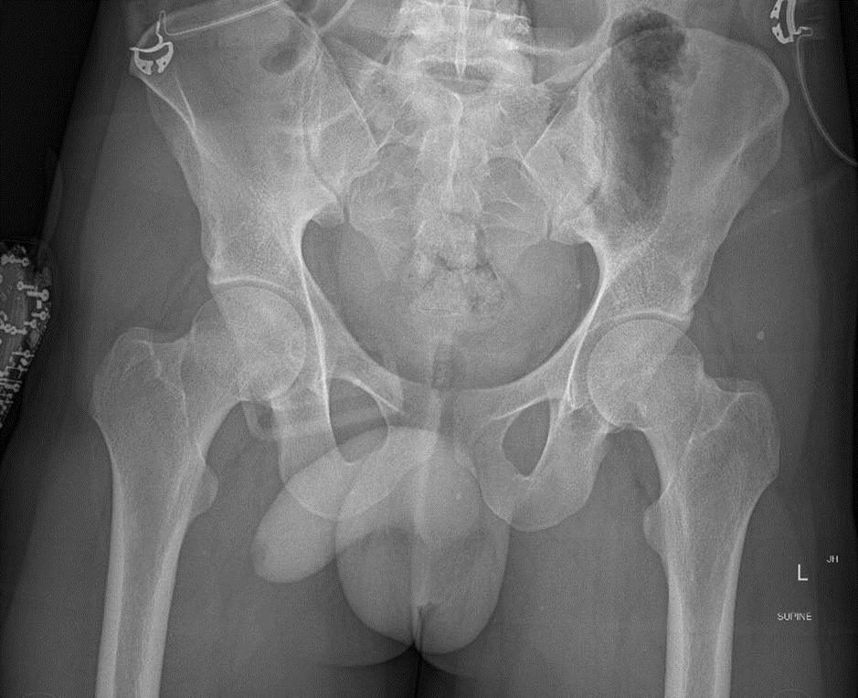
Pelvic x-ray

Slide 4
EFAST RUQ

Slide 5
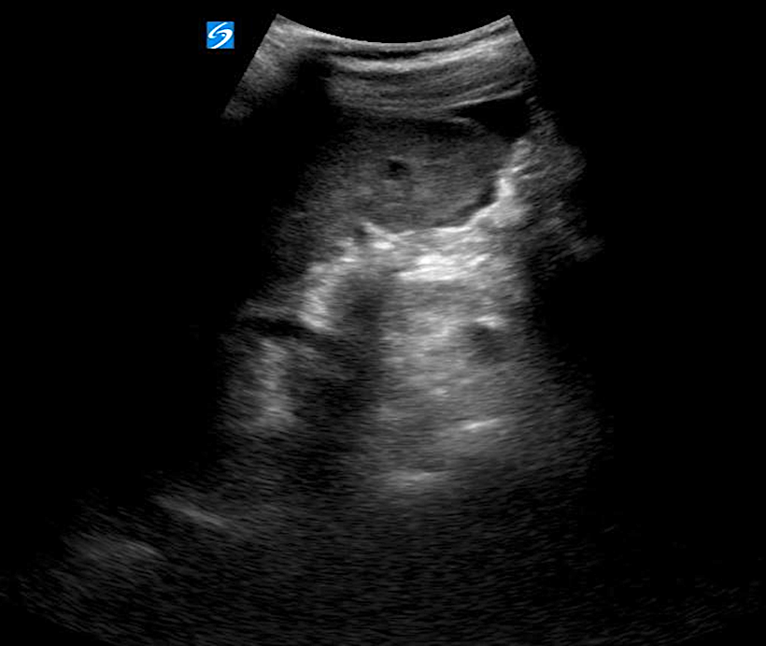
EFAST LUQ

Slide 6
EFAST bladder

Slide 7
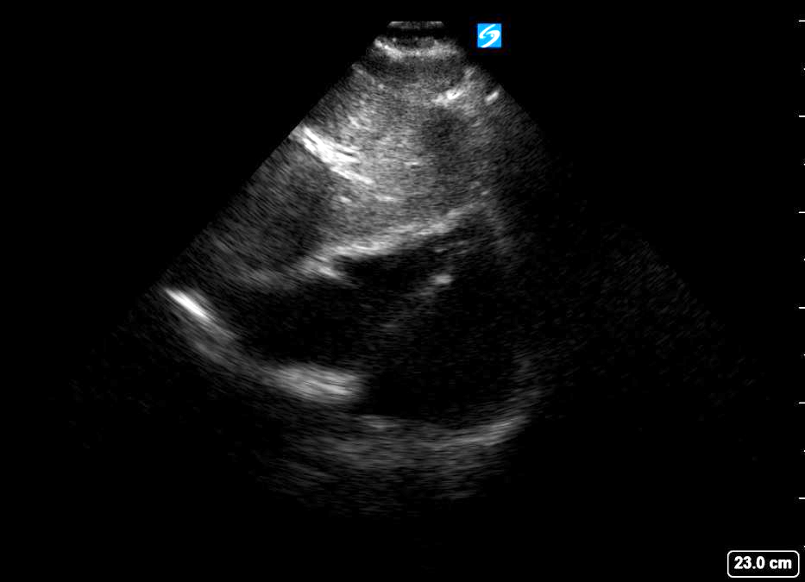
Subxiphoid

Slide 8
EFAST R lung

Slide 9
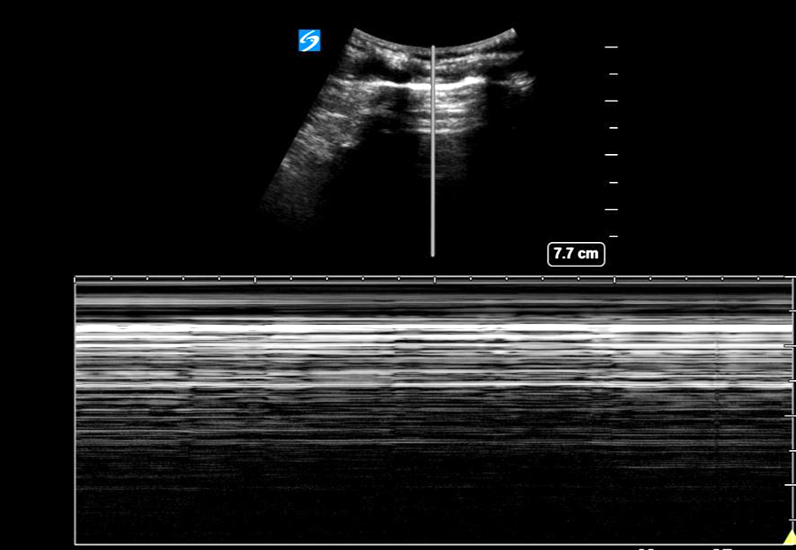
EFAST L lung

Slide 10
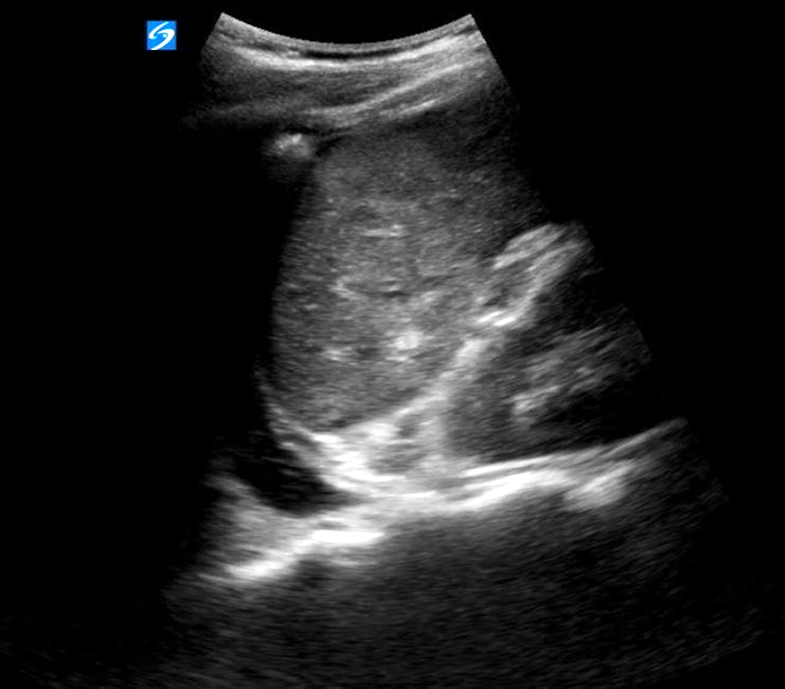
EFAST splenorenal

Slide 11
CT scan
https://vimeo.com/538909400/40d3a472d8

Slide 12
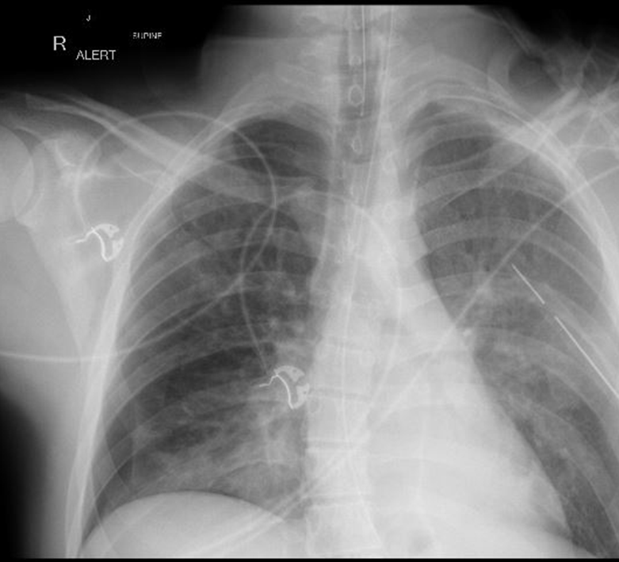
CXR post L ICC

Slide 13
CXR post R ICC

Slide 14
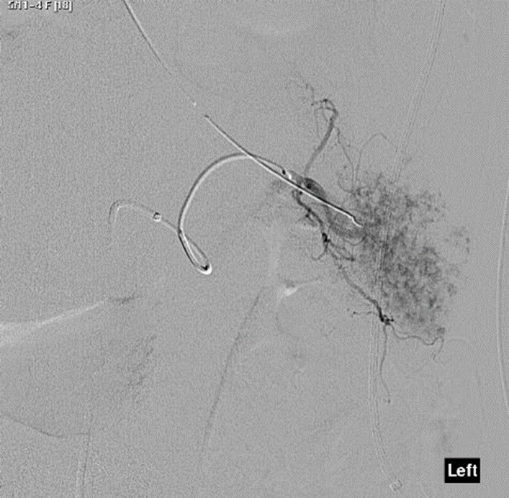
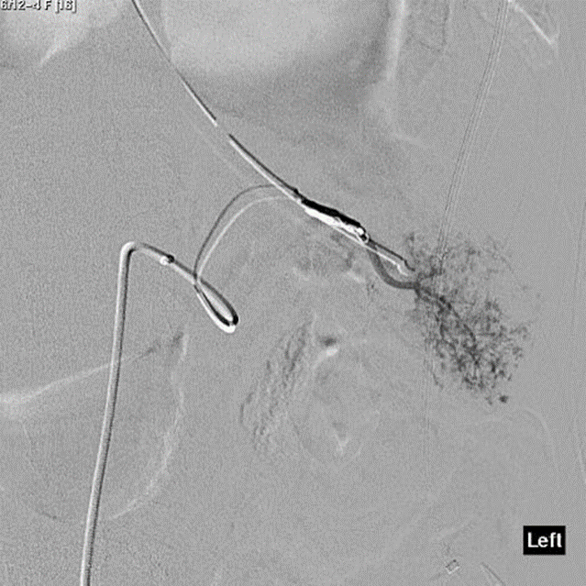
Splenic embolisation

Slide 15
Spleen Australia

Slide 16
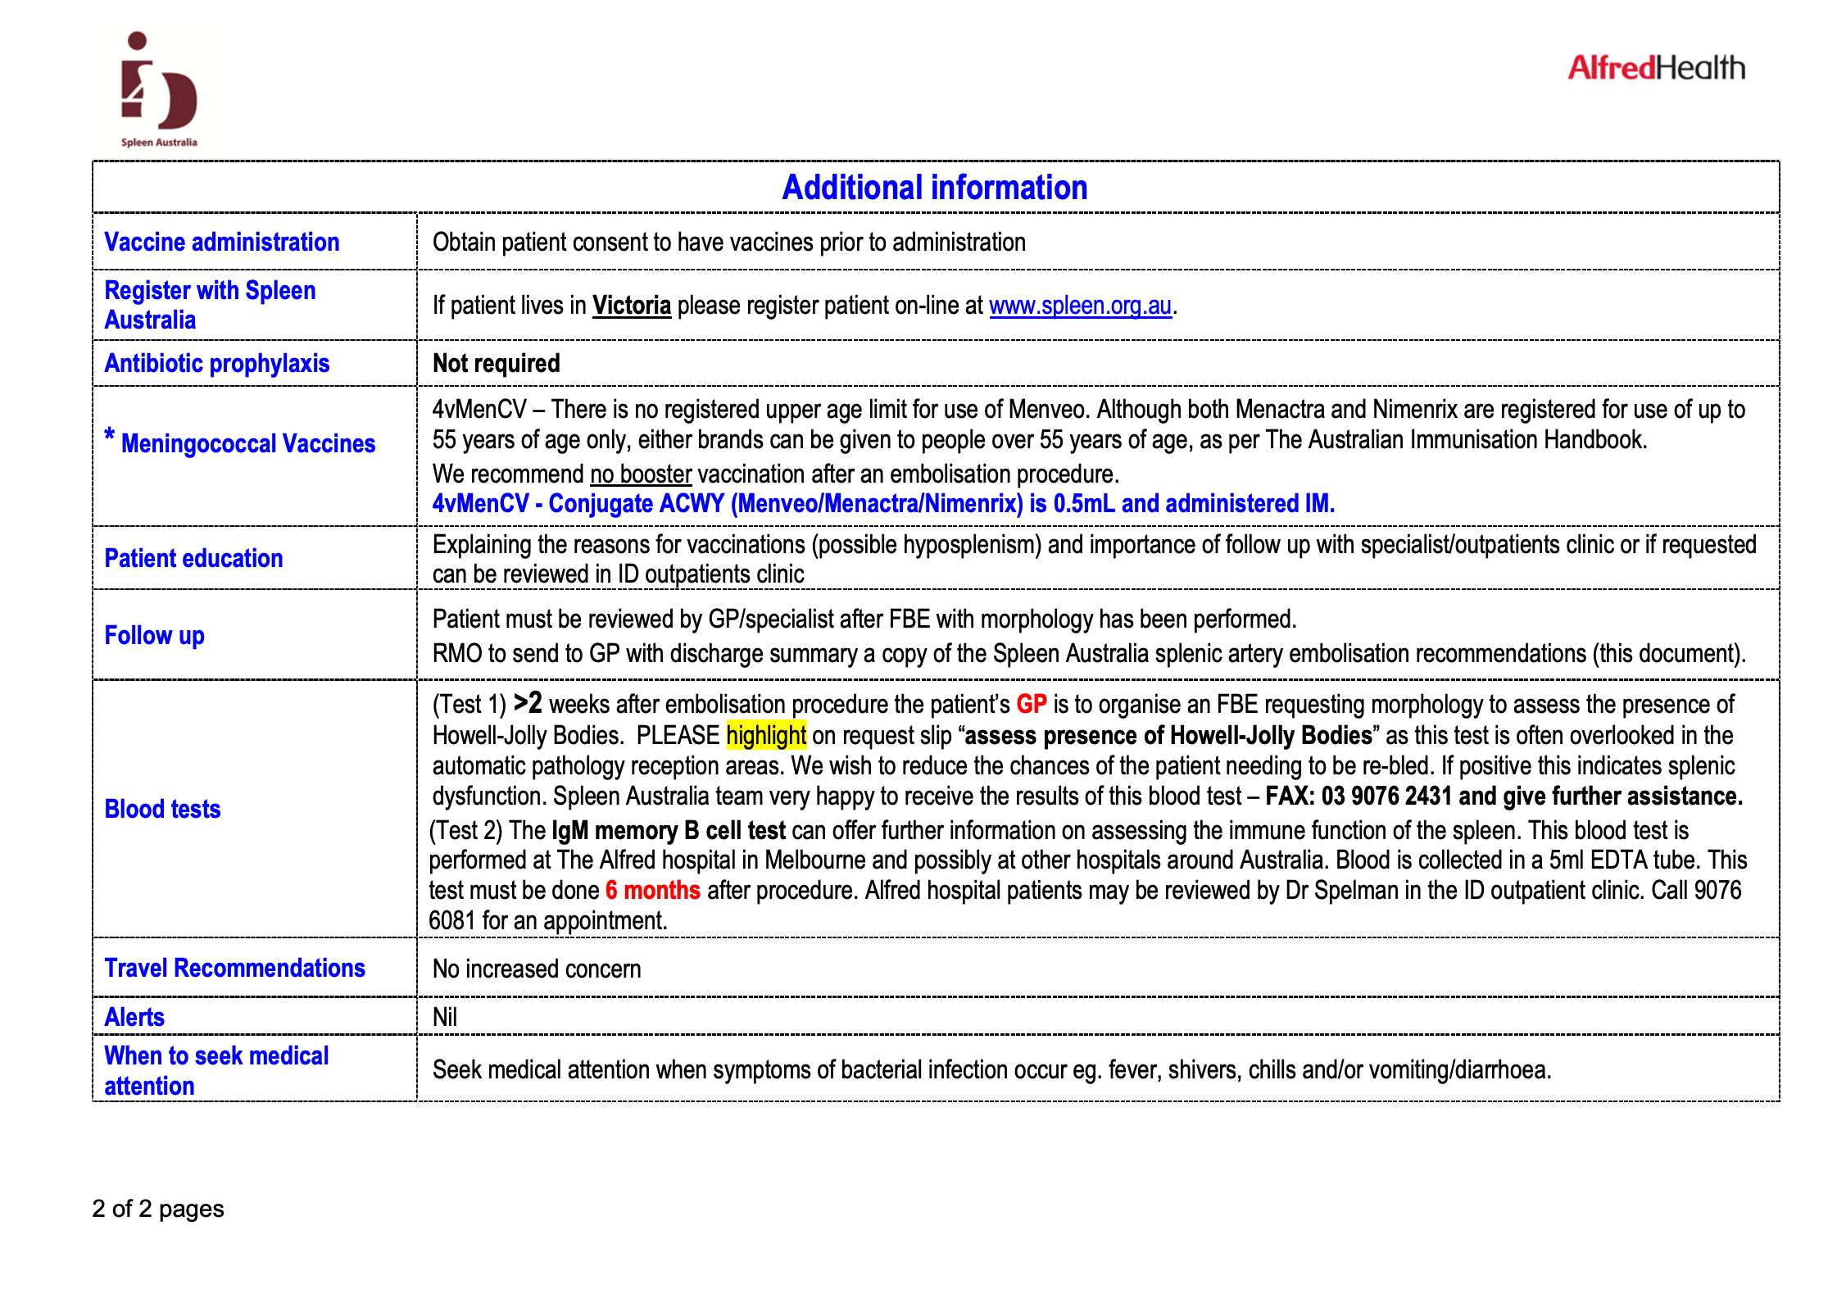
Immunisation schedule/guideline

